Slide 1

PS-1 Project
TITLE: ‘Digitization of the Employee Appraisal System’
At
National Textile Corporation Limited(Delhi)

Slide 2
Group Members
1.Uttara Ravi
2.Sahil Sangwan
3.Tanuj Gupta
4.Abhinav Jain

Slide 3
Outline of the Presentation
Introduction
Steps Involved in the creation of Portal
Phase I
Phase II
Phase III
Phase IV
Screenshots of Portal
Video Demonstration
Miscellaneous Features
Resources Used

Slide 4
Introduction
The objective is to digitize the employee appraisal process in NTC
The portal will bring about transparency and fasten the appraisal process
A database of employees (over 400) is simultaneously being created
Mr Thatha Rammanohar (Joint manager HR) guided us through the process

Slide 5
Steps Involved in the Creation of Portal
1. Understanding the appraisal process.
2. ER Diagram (mapping the relationships between DB tables)
6. Hosting on local machine and checking real time running of the portal.
3.Designing the front end of the portal.
5.Error analysis and debugging of the code.
4.Connecting forms to a database, connections to different pages.

Slide 6
Phase I (Understanding the appraisal process)
Read the HR manual containing Employee rules, policies, appraisal process etc
ER diagram was made to understand the relationships between all Database Tables and their unique identities

Slide 7
Phase II (Front End)
This phase involved designing the login pages, signup page and the forms used in the portal
This was achieved using HTML5, CSS3 and Bootstrap
Value checking in fields to avoid invalid entries
Implemented using JavaScript

Slide 8
Phase III (Back End)
The entries are stored in a database
It was constructed using SQL
The form entries submitted were connected to valid DB Tables
Accomplished using PHP
A total of 7 tables having over 150 attributes were made

Slide 9
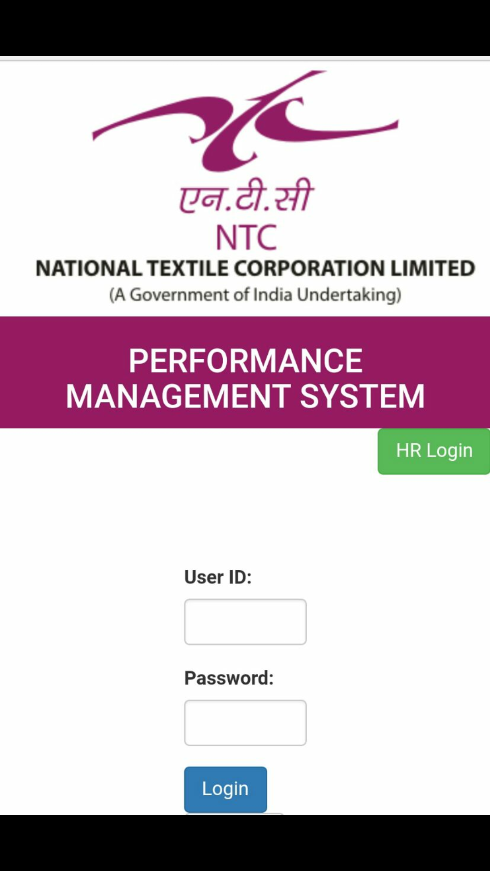
Phase IV (Mobile Compatibility)
Appraisal process can be done on mobiles
Mobile compatibility was added keeping this in mind
The Bootstrap framework (combines CSS, HTML and JavaScript) was used

Slide 10
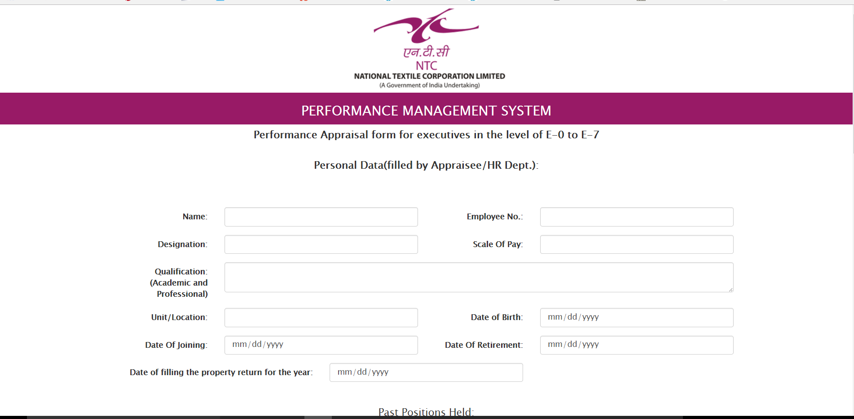
Screenshots of the Portal
Appraisal Form

Slide 11
Video Demonstration

Slide 12
Miscellaneous Features
Confirm Password
Password encryption using SHA1 implemented,functional once ‘Forgot Password’ is functional
Forgot Password
Operational once an E-mail server is functional
View Status of Form
Auto Filled forms for the Appraiser to view
Removes redundancy

Slide 13
Resources Used
Xampp(Acts as the local server on the laptop)
Stackoverflow.com
W3schools.com
NTC HR Manual

Slide 14
“Every once in awhile, a new technology, an old problem, and a big idea turn into an innovation”
- Dean Kamen

